Slide 1
BITS Pilani
Prof.Aruna Malapati
Asst Professor
Department of CSIS

Slide 2
Constituency Parsing

Slide 3
Today’s Agenda
Grammar equivalence and normal forms
Constituency Parsing
Cocke - Kasami Younger (CKY) algorithm
Partial Parsing / Chunking
Early Parsing Algorithm

Slide 4

Grammar Equivalence and Normal Form
Two kinds of grammar equivalence
Weak equivalence: Generate same set of strings and same phrase structure
Strong equivalence: same set of strings but do not assign the same phrase structure to each sentence.
Chomsky normal form
ɛ-free
Two forms of productions A->B C or A->a.

Slide 5
Example
NP -> the nominal
NP -> DT nominal
DT -> the
NP -> DT noun PP
NT -> noun PP
NP -> DT NT

Slide 6
Constituency Parsing
Syntactic parsing is the task of recognizing a sentence and assigning a syntactic structure to it.
Ambiguity
Attachment ambiguity
Coordination ambiguity

Slide 7
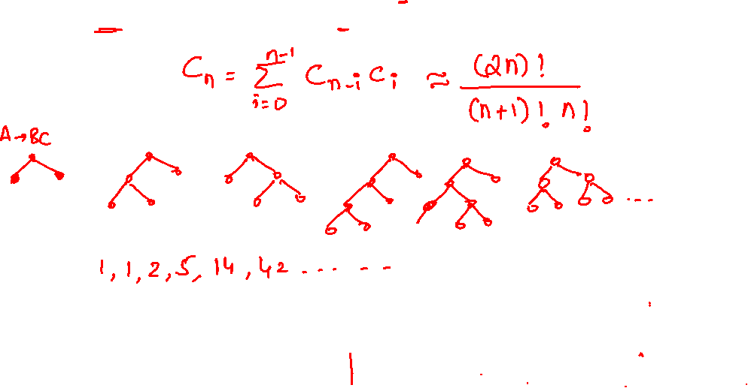
Number of parse trees
A parse tree of a sentence of length n consists of binary treewith n-1 internal nodes and n terminals nodes.

Slide 8
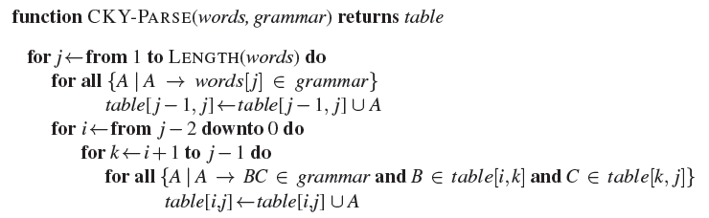
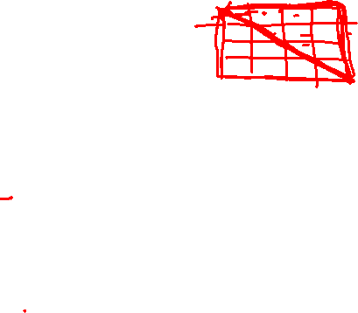



Cocke - Kasami Younger (CKY) algorithm

Slide 9

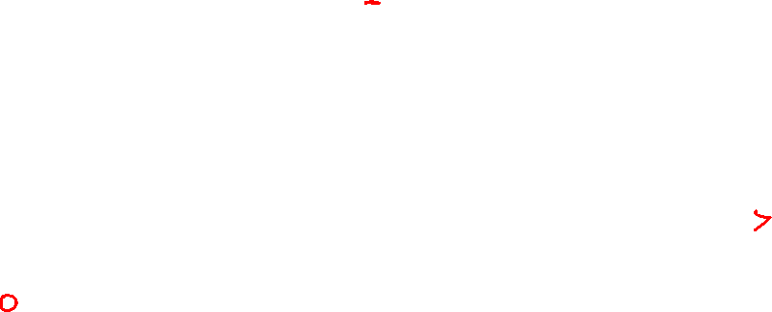
CKY Algorithm
CKY uses a 2D matrix to encode the structure of the tree.
For a sentence of length n, we will use an (n+1)x(n+1) matrix.
You can think of the indices as pointing at the gaps between the input words.
All constituents that can span positions i through j of the input will be stored in the cell (i,j).
the flight includes a meal

Slide 10
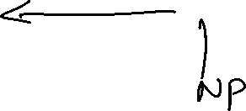




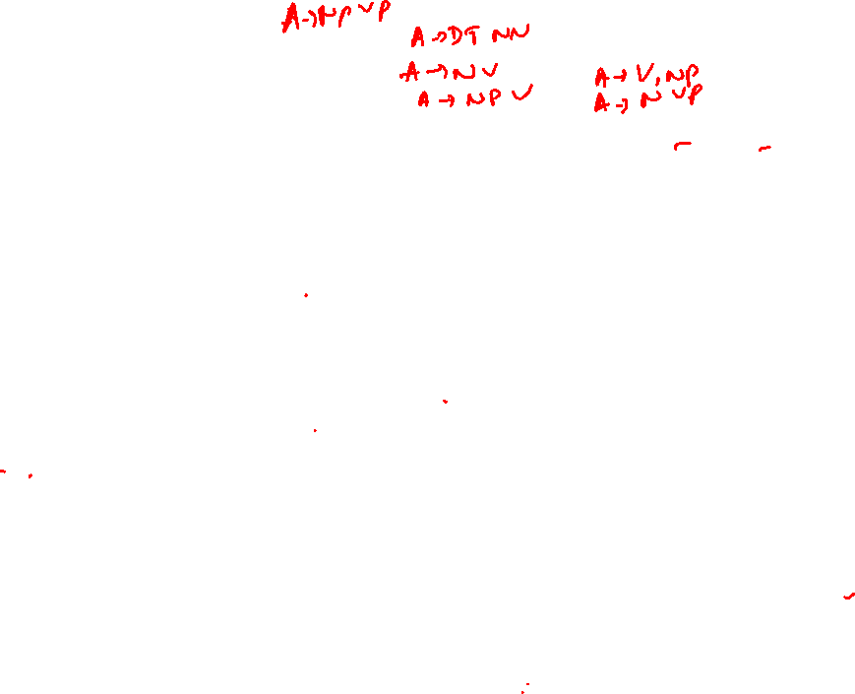



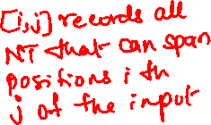
CKY algorithm - example
0 the. 1 flight 2 includes 3 a 4 meal 5
S -> NP VP
NP -> DT N
VP -> V NP
V -> includes
DT -> the
DT -> a
N -> flight
N -> meal

Slide 11










































CKY algorithm

Slide 12
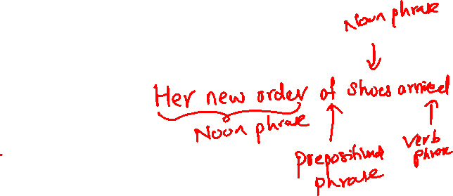
Partial Parsing / Chunking
What if we don’t need a full parse tree?
Full parse tress can be complex
and time-consuming to build.
Many NLP tasks don’t require full
hierarchical parses.

Slide 13
Chunking
Processing of finding the non overlapping, non recursive constitutes in an input text.
Noun Phrases
Verb Phrases
Prepositional Phrases
Adjective Phrases

Slide 14
Chunking: Fundamental Tasks
1. Segmentation
2. Labelling
Identify non overlapping,
fundamental phrases
Assign labels to phrases

Slide 15
How do we segment text into chunks?
BIO tagging
I: Tokens inside a chunk
O: Tokens outside any chunk
B: Tokens beginning a chunk
Generally framed as a sequence labelling task.

Slide 16
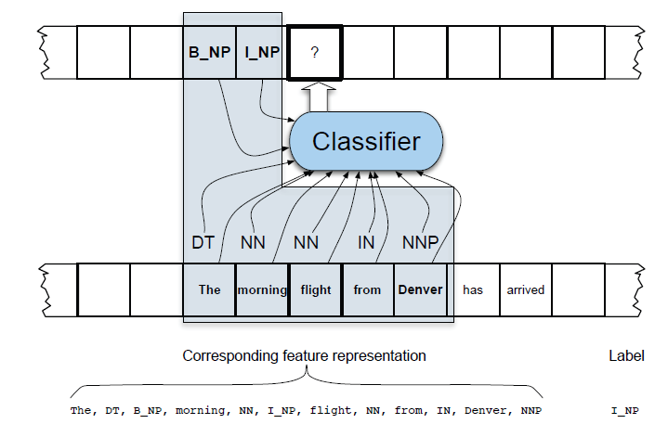
Machine Learning-Based Approaches to Chunking

Slide 17



Chunking-System Evaluations
Precision
Recall
F-measure

Slide 18
Early Parsing Algorithm
Top down dynamic programming approach.
Table length is (n+1), where n is the number of words.
An early parsing algorithm moves through n+1 sets of states in the chart in the order.
At each step, one of the three operators are applied
Predictor
Scanner
Completer

Slide 19

Predictor
Creates new states
Applied to any state that has a non-terminal immediately to the right of its dot (as long as the non-terminal is not a POS category)
New states are placed into the same chat entry as the generating state
They begin and end at the same point in the input where the generating state ends.

Slide 20

Example
S->.VP,[0,0]
VP->.Verb, [0,0]
VP -> .Verb NP, [0,0]
VP -> .Verb NP PP, [0,]
VP-> .Verb PP,[0,0]
VP -> VP PP,[0,0]

Slide 21
Scanner
Used when a state has a POS category to the right of the dot.
Examines input and incorporates a state corresponding to the prediction of a word with a particular POS into the chart.
VP -> . Verb NP,[0,0]
Since category following the dot is a part of speech (verb)
Verb -> book.,[0,0]

Slide 22
Completer
Applied to a state when its dot has reached the right end of the rule.
Indicates that the parser has successfully discovered a particular grammatical category over some span of input.
Finds all previously created sates that were searching for this grammatical category, and creates new states that are copies with their dots advanced past the grammatical category.

Slide 23

Example
Book that flight
DT -> that | this | a | the
Noun -> book | flight | meal | money
Verb -> book | include | prefer
S -> NP VP
S -> VP
NP -> DT NT
NT -> Noun
VP -> Verb
VP -> Verb NP

Slide 24

Example
State | Rule | Start, End | Action
S0 | Γ -> . S | 0,0 | Start State
S1 | S-> . NP VP | 0,0 | Predictor
S2 | S -> . VP | 0,0 | Predictor
S3 | NP -> . DT NT | 0,0 | Predictor
S4 | VP -> . Verb | 0,0 | Predictor
S5 | VP -> .Verb NP | 0,0 | Predictor
S6 | Verb -> book. | 0,1 | Scanner
S7 | VP -> Verb. | 0,1 | Completer
S8 | VP -> Verb . NP | 0,1 | Completer
S9 | S -> VP. | 0,1 | Completer
S10 | NP -> .DT NT | 1,1 | Predictor
S11 | Dt->that. | 1,2 | Scanner
S12 | NP-> DT . NT | 1,2 | Completer
S13 | NT -> . Noun | 2,2 | Predictor
S14 | Noun -> flight. | 2,3 | Scanner
S15 | NT-> Noun. | 2,3 | Completer
S16 | NP -> DT NT . | 1,3 | Completer
S17 | VP -> Verb NP. | 0,3 | Completer
S18 | S-> VP. | 0,3 | Completer

